Slide 1
Student Performance Data

Slide 2
Steps
Peeking into data
Data samples
Types for each columns
Cleaning the data
Column names
Null checks
Data conversion
Scoring
Dependent variable - Grades
Independent variable
Familial factors
External factors
Data comparison & Visualization

Slide 3
Peeking into the data

Slide 4
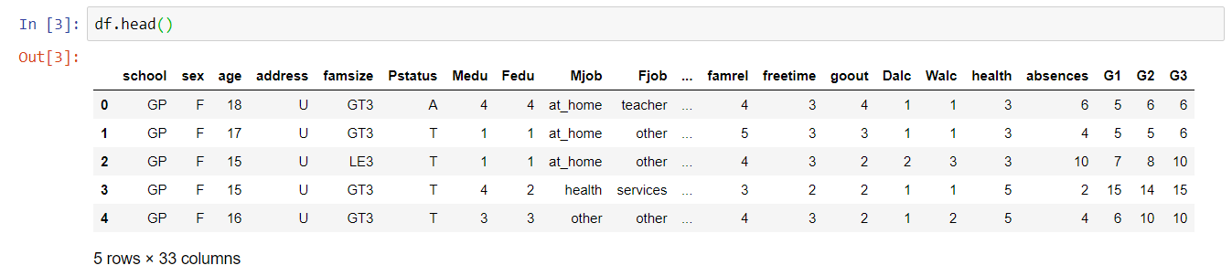
Data samples

Slide 5
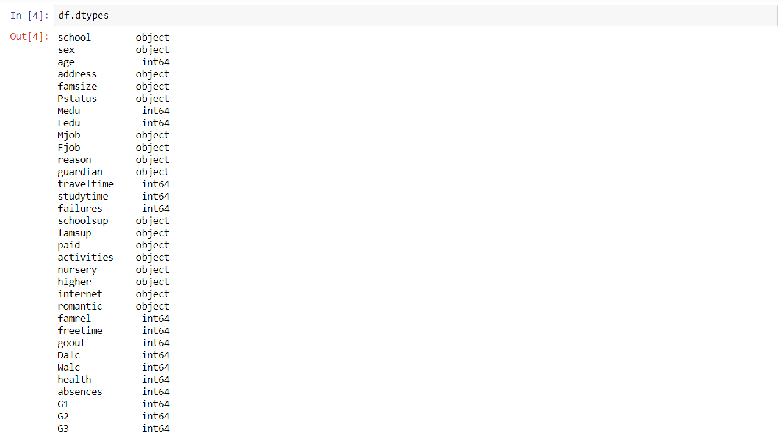
Types of data available

Slide 6
Cleaning the data

Slide 7
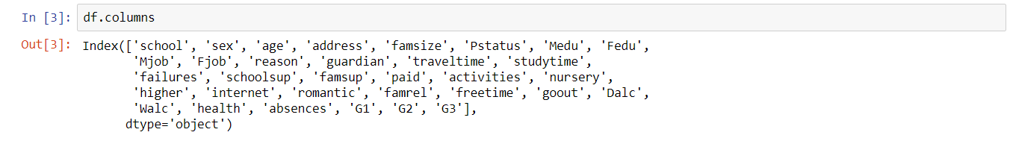
Columns within the data

Slide 8
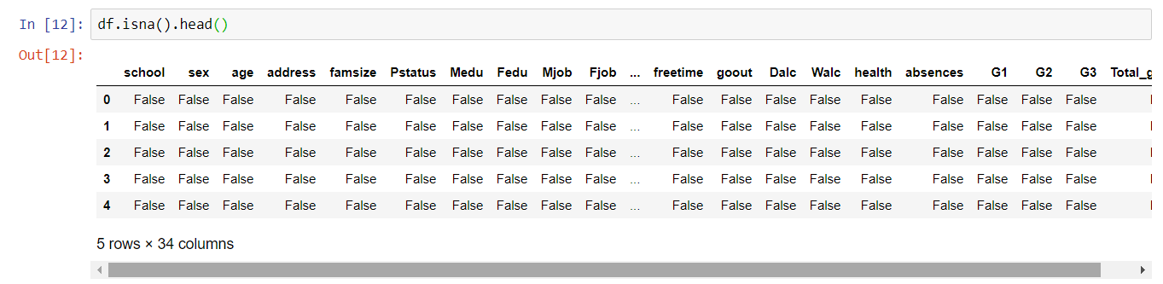
Checking for nulls

Slide 9
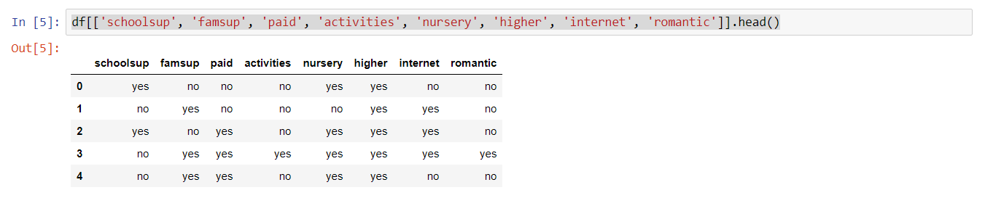
The boolean

Slide 10
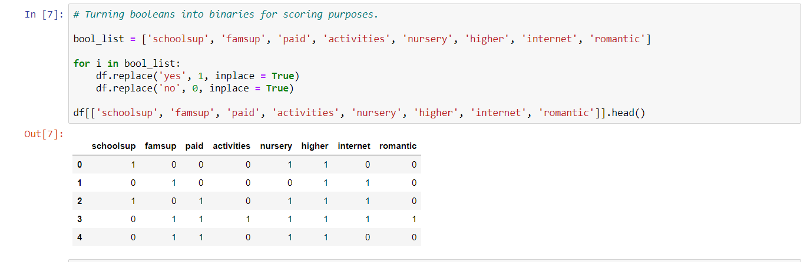
Binary conversion of boolean

Slide 11
Variable creation

Slide 12
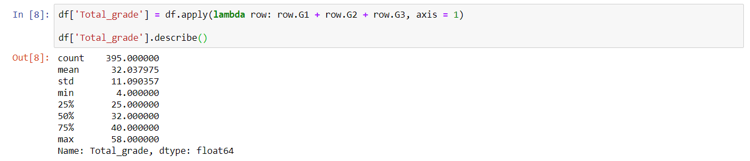
Grade total & It’s description
This will be the dependent variable for the independent variables

Slide 13
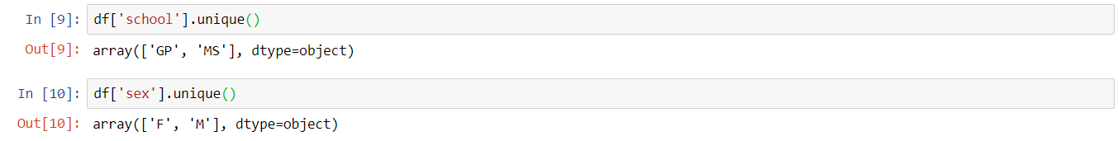
But that information is not useful
There are numerous variables that may affect the grades. For now, we’ll move on to the creation of independent variables to compare.

Slide 14
Familial factors
Variables that may impact a child’s learning:
Parental education level
Family Relationships
Family supports
Other variables
For now, just the three variables mentioned above.
The two variables are Booleans, so impact of each variables have to be decided. For now, assume that quantitatively, each variable will enhance the child’s learning by 3 times respectively.

Slide 15
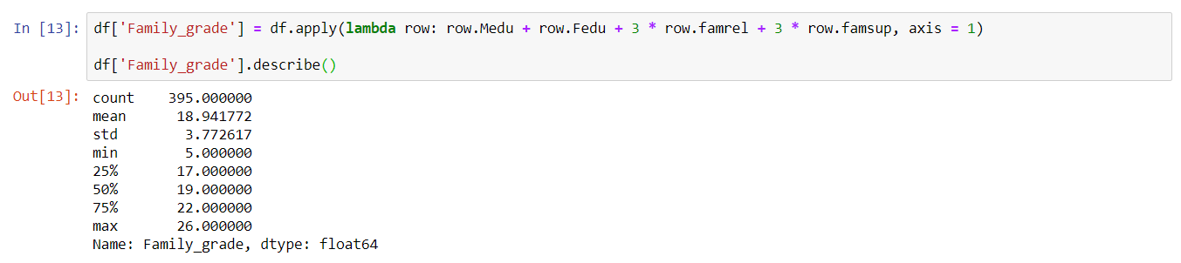

Slide 16
External factors
Variables involved:
Time spent travelling, studying
Activities
School support
Free time
Absences (Negative impact)
Internet access

Slide 17
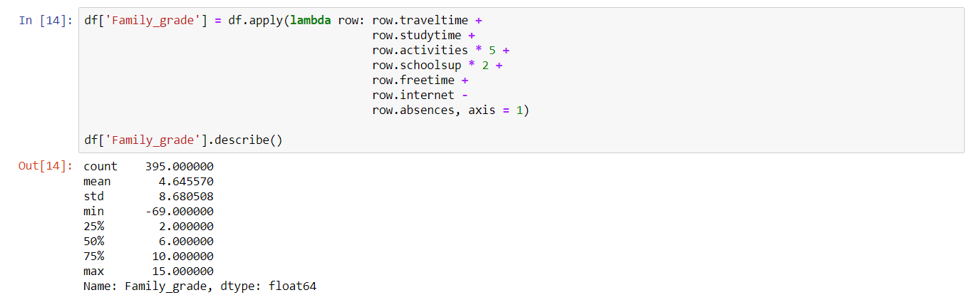
Note: These are subjective judgement. Impact of each variable requires hypothesis testing for better accuracy.

Slide 18
Comparisons & Visualisations

Slide 19
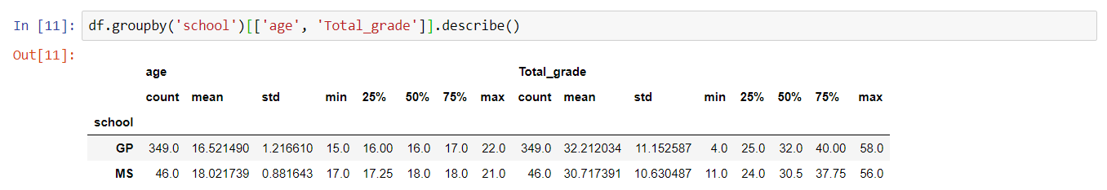
Comparison between schools
Comparing without the influences.

Slide 20
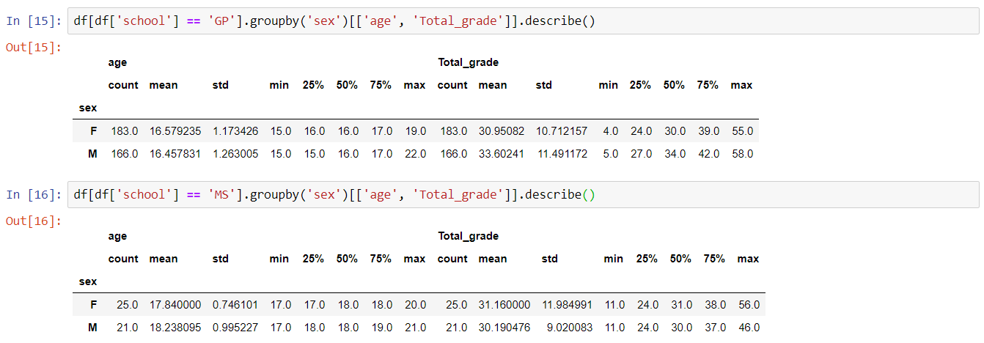
Within each school

Slide 21
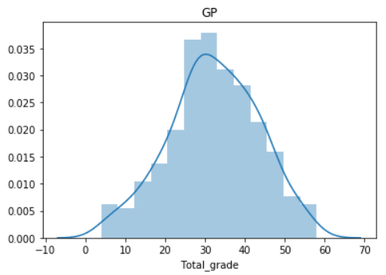
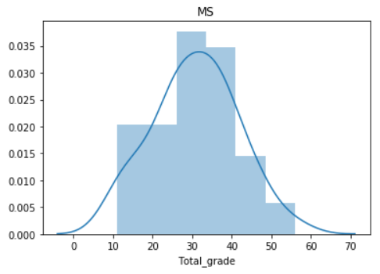
Normality of the Total Grade for each school
For GP
For MS
Skewness = -0.16352547525650318
Kurtosis = -0.31799566578228955
Skewness = 0.018981394120414604
Kurtosis = -0.30688442542490746

Slide 22
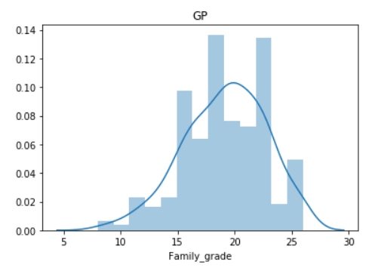
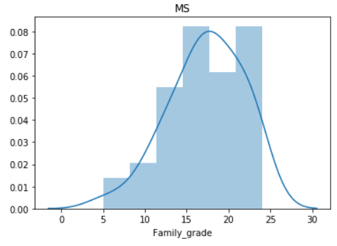
Normality of the Family Grade for each school
For GP
For MS
Skewness = -0.3506962450377173
Kurtosis = -0.1600051934134874
Skewness = -0.559253000796173
Kurtosis = 0.05909517046160673

Slide 23
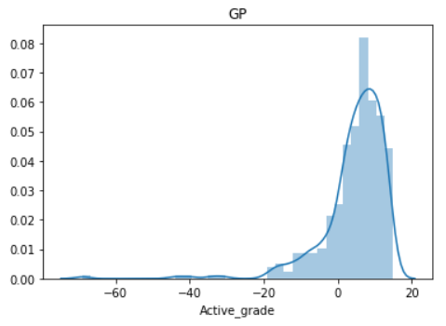
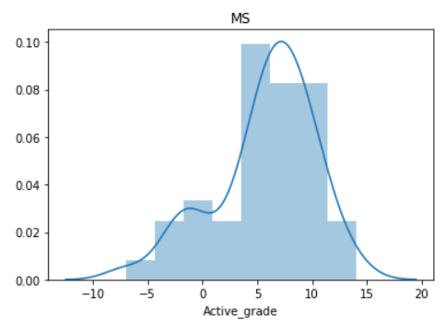
Normality of the Active Grade for each school
For GP
For MS
Skewness = -3.078687064586393
Kurtosis = 16.46662002168347
Skewness = -0.8126895275423571
Kurtosis = 0.40499992895925896

Slide 24
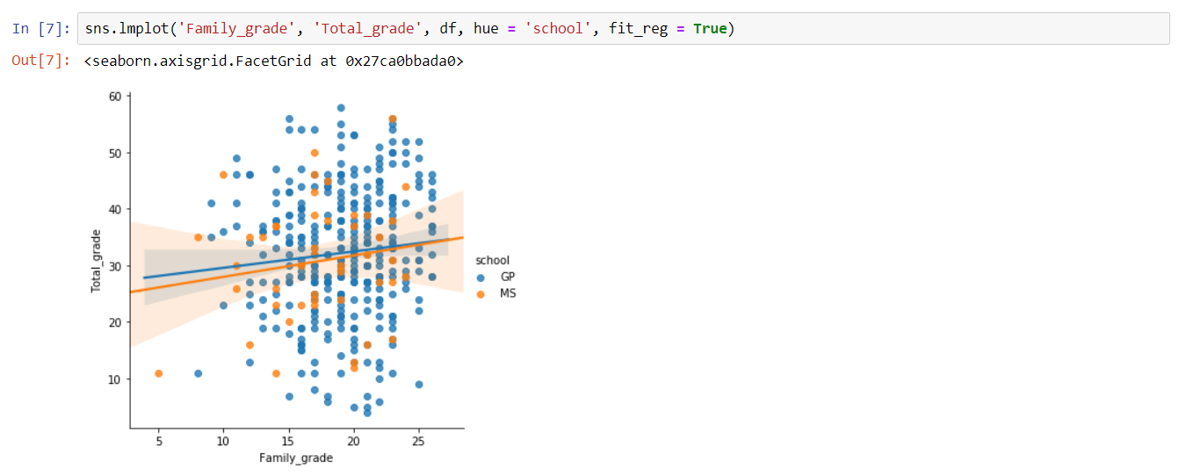
Visually when comparing the variables

Slide 25
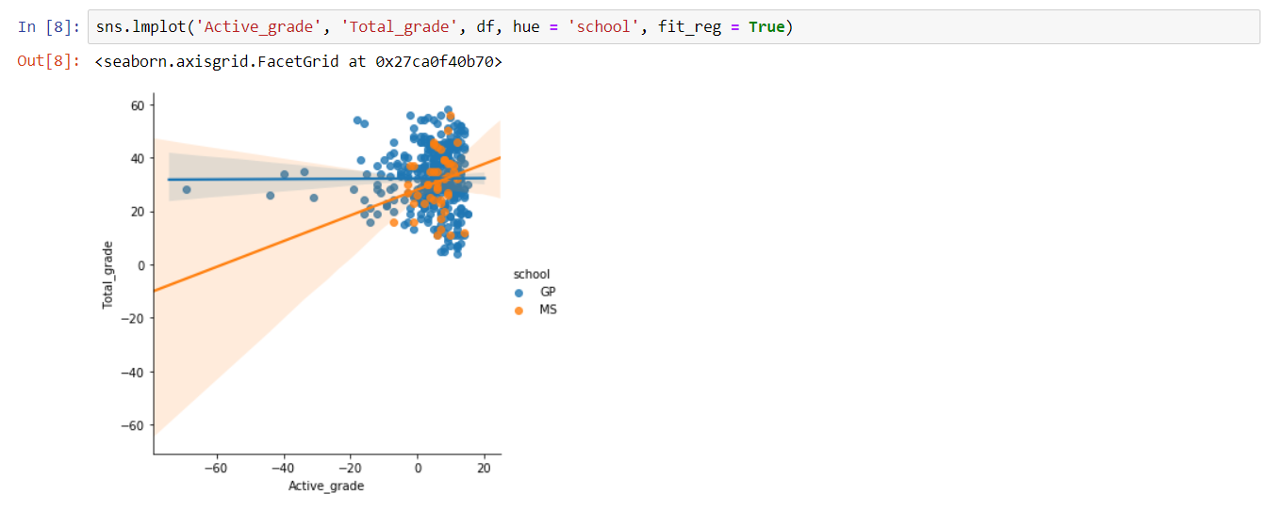

Slide 26
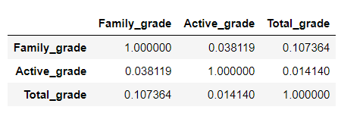
Correlations

Slide 27
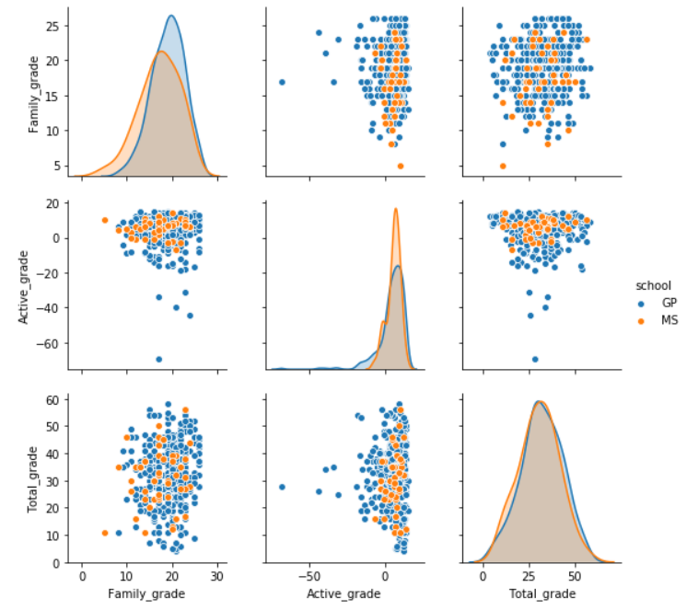

Slide 28
Conclusion
Insufficient samples from one school, “MS”
Most independent variables are not normally distributed
The dependent variable is normally distributed
Correlations show that there is no correlations between the independent variables to the dependent variables

